Slide 1

CSC 411 Neural Network
By: Shawn Merana

Slide 2
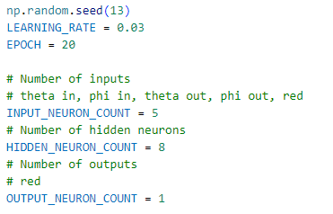
Initial Variables

Slide 3
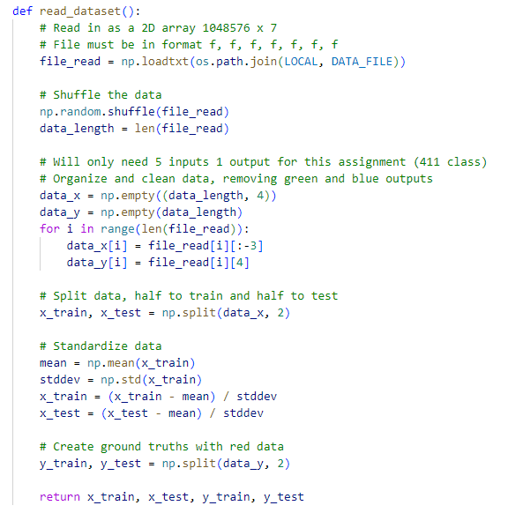
Data Reader
Code snippet of how the data is inputted and manipulated

Slide 4
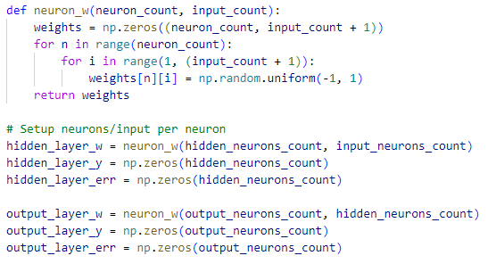
Neuron Creation
Creation of the neurons. First input is the number of neurons in the layer. Second input is how many inputs does each neuron have.
Input
Hidden
Hidden
Output
Input
Hidden

Slide 5
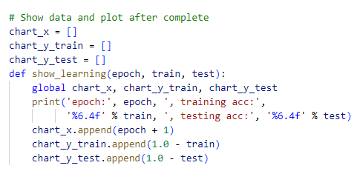
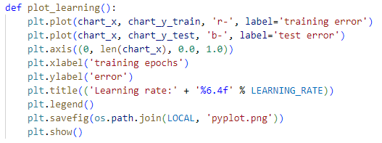
Data and Plotting
Code snippets for how the learning is doing, as well as final plot

Slide 6
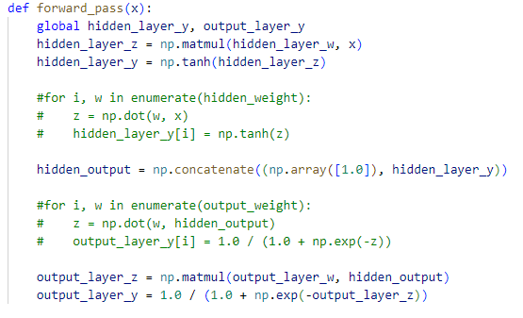
Forward Pass
Forward pass using matrix.
The matrix is used to calculate all weights and the input data.
First is the activation hidden layer using the tanh of the matrix multiplication.
Second is activation of output using results from first and current weights

Slide 7
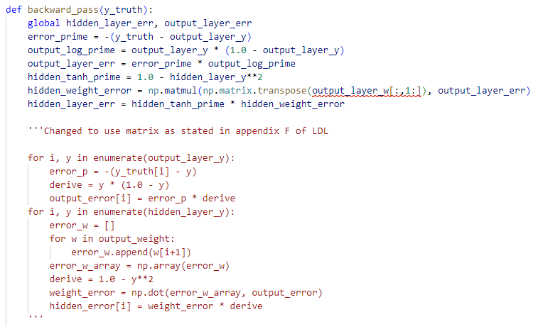
Backward Pass

Slide 8
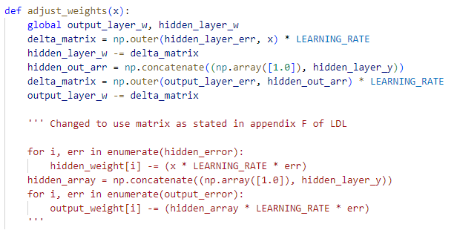
Adjustments
Uses matrix multiplication for determining the amount to adjust the weights

Slide 9
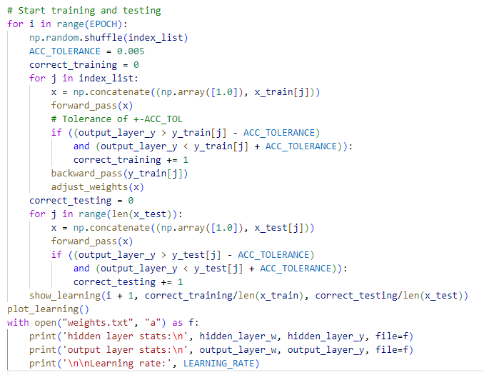
Runner Code

